Slide 1
INTRODUCTION TO EPIGENOME-WIDE ASSOCIATION STUDIES (EWAS)
2. PRE-PROCESSING OF DNA METHYLATION DATA
(THEORY)

Slide 2
EPIGENOME-WIDE ASSOCIATION STUDY (EWAS)
Workflow
Scientific question
Study population
Biological sample
DNA methylation data acquisition
Quality control of DNA methylation data
Epigenome-wide association study (EWAS)
Meta-EWAS or replication / validation
Biological interpretation

Slide 3

EPIGENOME-WIDE ASSOCIATION STUDY (EWAS)
Workflow
Scientific question
Association study: Which are the CpGs (pathways) associated with tobacco smoking?
Prediction study: Which is the smoking status of an individual (based on their methylation)?
Study population
Biological sample
DNA methylation data acquisition
Quality control of DNA methylation data
Epigenome-wide association study (EWAS)
Meta-EWAS or replication / validation
Biological interpretation

Slide 4
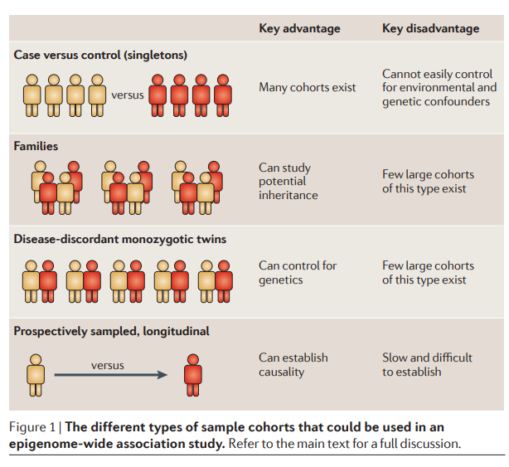
EPIGENOME-WIDE ASSOCIATION STUDY (EWAS)
Workflow
Scientific question
Study population
Observational study
Case-control study
Cohort study
Experimental study
Biological sample
DNA methylation data acquisition
Quality control of DNA methylation data
Epigenome-wide association study (EWAS)
Meta-EWAS or replication / validation
Biological interpretation
Rakyan et al Nat Rev Genet 2011

Slide 5
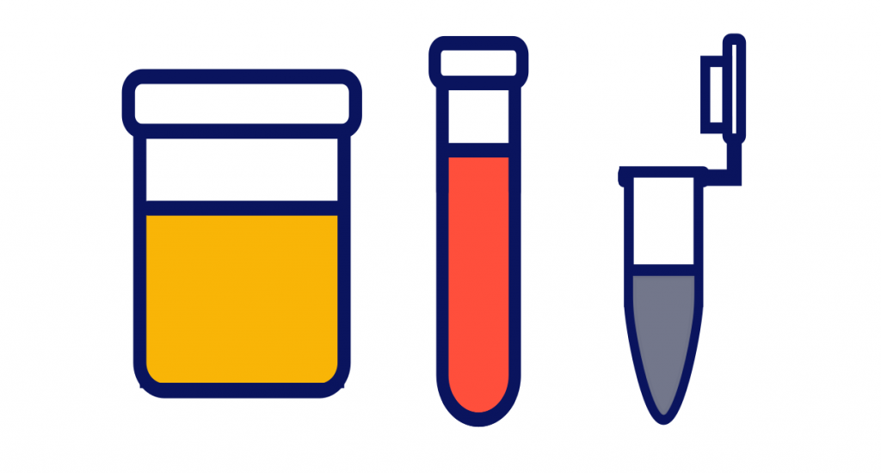
EPIGENOME-WIDE ASSOCIATION STUDY (EWAS)
Workflow
Scientific question
Study population
Biological sample
DNA methylation data acquisition
Quality control of DNA methylation data
Epigenome-wide association study (EWAS)
Meta-EWAS or replication / validation
Biological interpretation

Slide 6
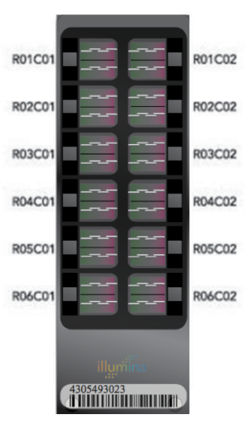
EPIGENOME-WIDE ASSOCIATION STUDY (EWAS)
Workflow
Scientific question
Study population
Biological sample
DNA methylation data acquisition
Quality control of DNA methylation data
Epigenome-wide association study (EWAS)
Meta-EWAS or replication / validation
Biological interpretation

Slide 7
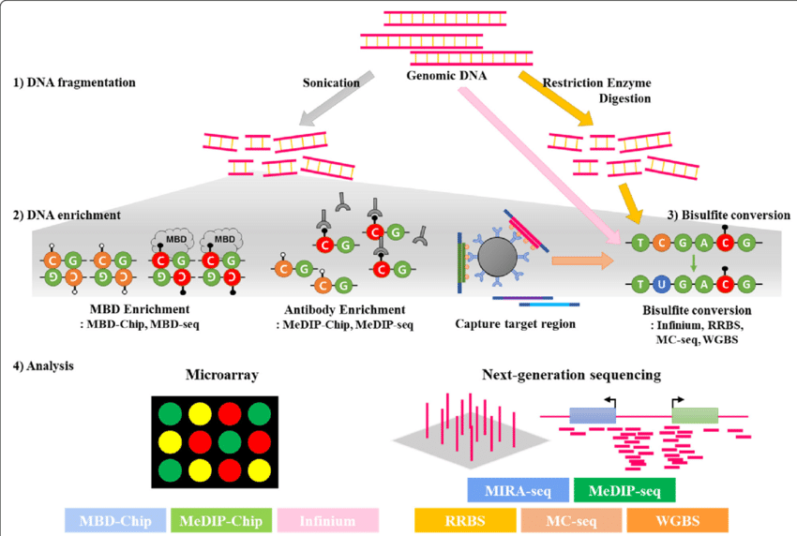
5. DNA METHYLATION QUANTIFICATION
Methods
MBD: methyl-CpG-binding domain
MeDIP: methylated DNA immunoprecipitation
Infinium: Illumina Infinium 450/EPIC BeadChips
RRBS: reduced-representationbisulfite-sequencing
MC-seq: methyl-capture sequencing
WGBS: whole-genome bisulfite sequencing
Lee et al BMC Genomics 2018

Slide 8
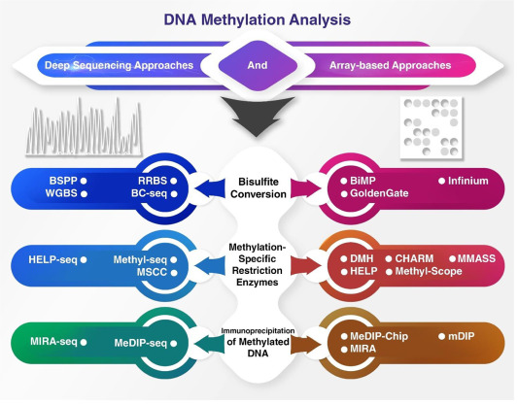
5. DNA METHYLATION QUANTIFICATION
Methods
Chenarani et al. Genomics 2021

Slide 9
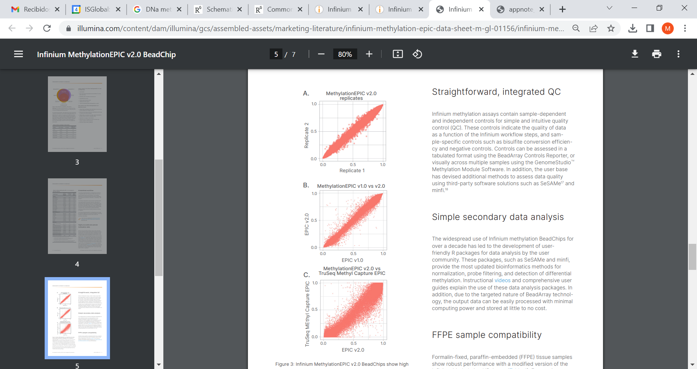
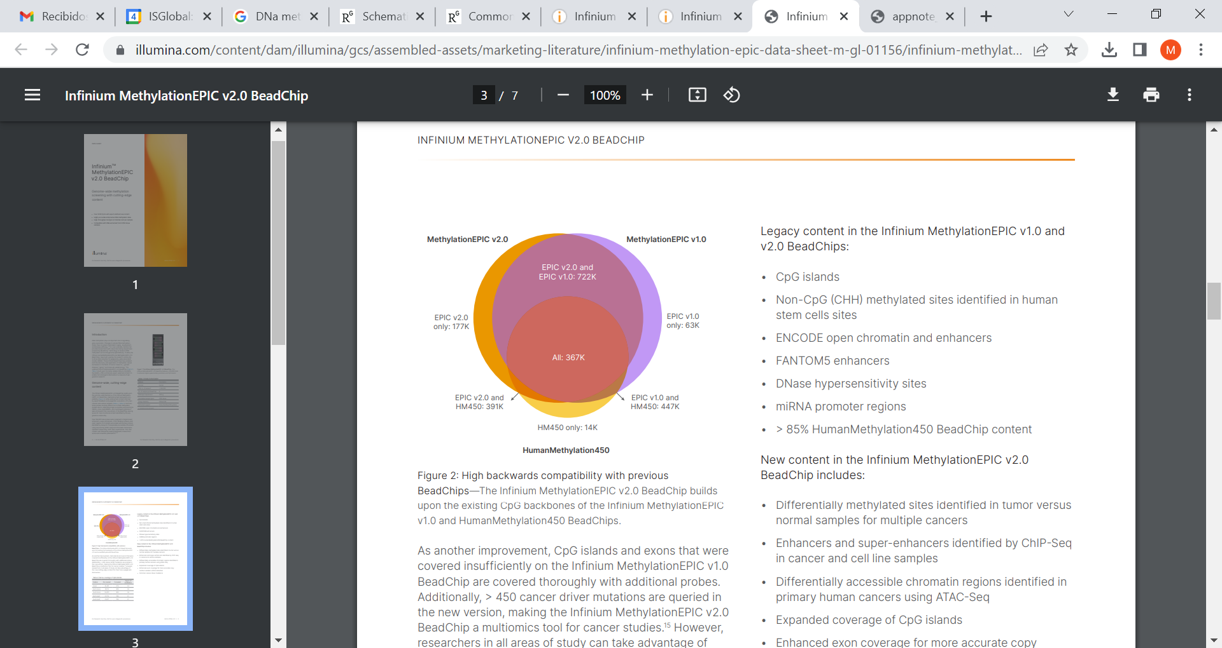
5. DNA METHYLATION QUANTIFICATION
Illumina Infinium BeadChips
Advantages:
Comprehensive genome-wide coverage
Assay reproducibility
User-friendly, streamlined workflow
Available in many cohort studies
Arrays:
GoldenGate: 1500 CpGs (cancer)
27K: 27K CpGs (promoters of 14K genes)
450K: 480K CpGs (27K + 99% RefSeq genes + others)
EPIC v1: 850K CpGs (90% 450K + Regulatory elements)
EPIC v2: 850K CpGs (90% 450K + Regulatory elements + cancer)

Slide 10
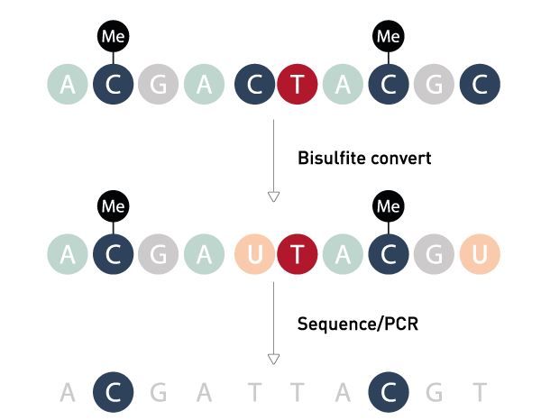
5. DNA METHYLATION QUANTIFICATION
Illumina Infinium technology
Bisulfite conversion

Slide 11
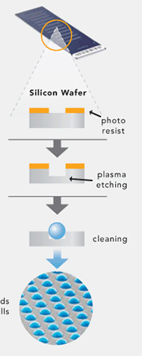
5. DNA METHYLATION QUANTIFICATION
Illumina Infinium technology
Bisulfite conversion
2) BeadChip hybridization
>1 bead per CpG

Slide 12
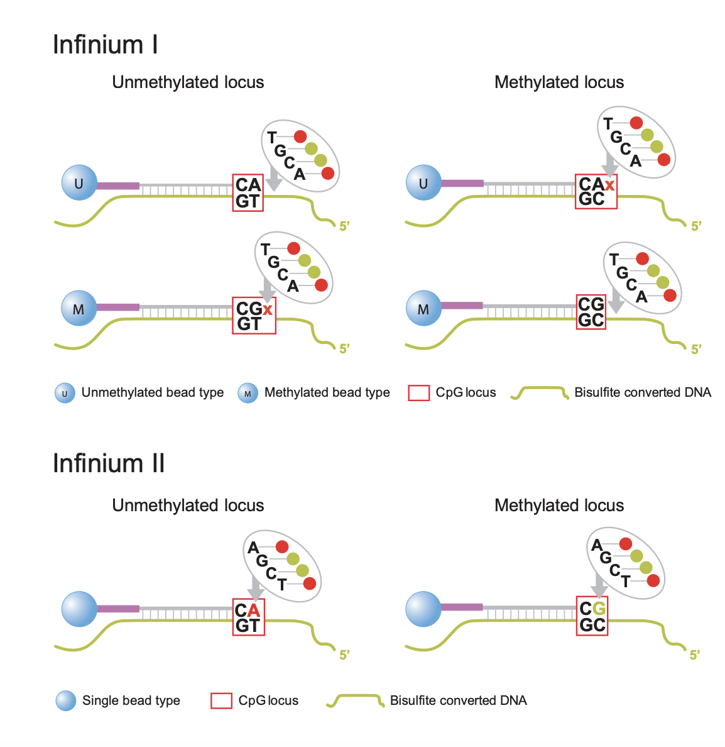
5. DNA METHYLATION QUANTIFICATION
Illumina Infinium technology
Infinium I probes
Infinium II probes
U
M
M+U

Slide 13
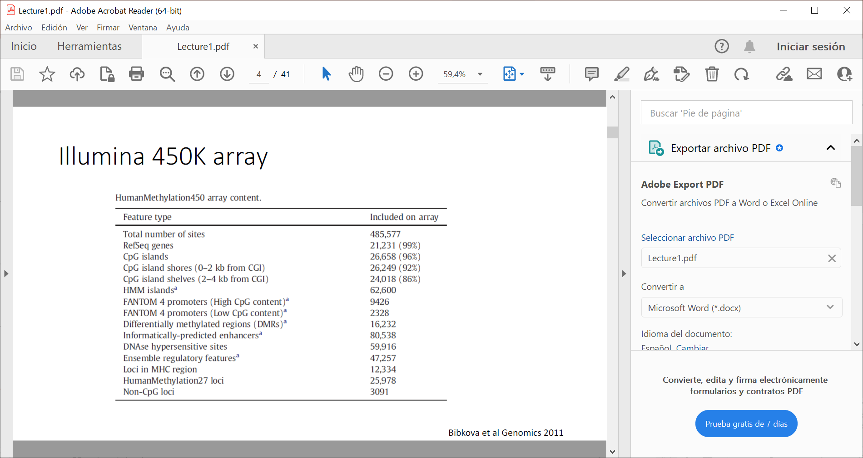
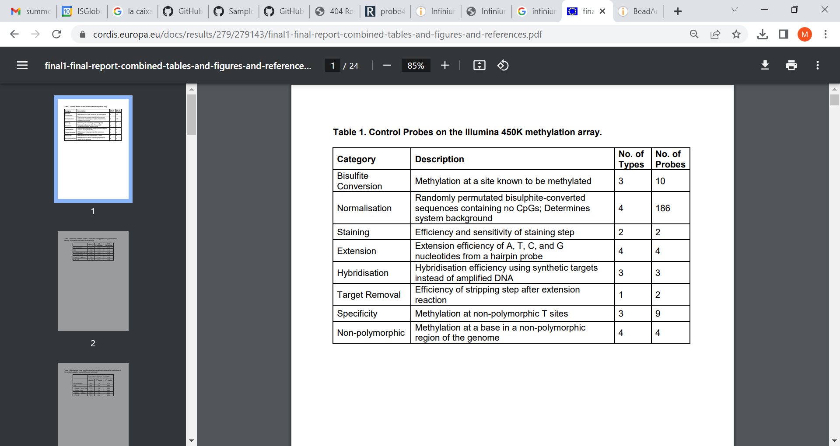
5. DNA METHYLATION QUANTIFICATION
Illumina Infinium probes

Slide 14
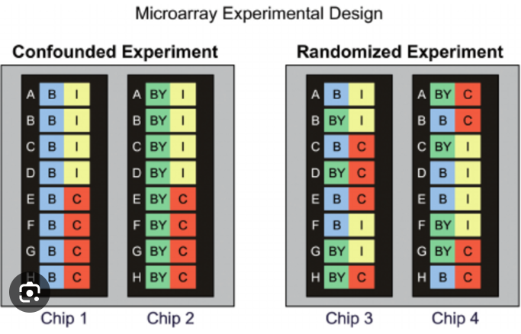
5. DNA METHYLATION QUANTIFICATION
Experimental design
Randomize samples across technical batch variables
Collection
Hospital
Time of the day
DNA extraction batch
Bisulfite conversion batch
Array
-> complete randomization
Include replicates
Include positive controls

Slide 15
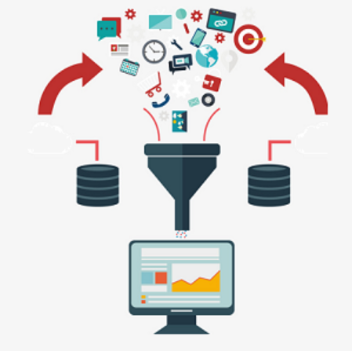
EPIGENOME-WIDE ASSOCIATION STUDY (EWAS)
Workflow
Scientific question
Study population
Biological sample
Experimental design
DNA methylation data acquisition
Quality control of DNA methylation data
Epigenome-wide association study (EWAS)
Meta-EWAS or replication / validation
Biological interpretation

Slide 16
6. QUALITY CONTROL OF DNA METHYLATION DATA
Quality control of DNA methylation data
Reduce variability introduced during the experimental process, while keeping true biological variation.
Import raw IDAT files
Sample quality control
Probe quality control
Normalization
PCA and technical batch effect correction
Control of outlier values

Slide 17
6. QUALITY CONTROL OF DNA METHYLATION DATA
Quality control of DNA methylation data
Reduce variability introduced during the experimental process, while keeping true biological variation.
Import raw IDAT files
Sample quality control
Probe quality control
Normalization
PCA and technical batch effect correction
Control of outlier values

Slide 18
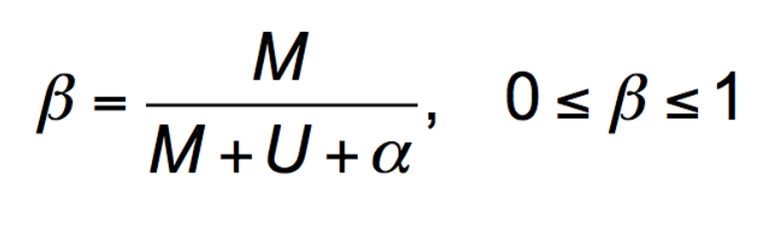
6. QUALITY CONTROL OF DNA METHYLATION DATA
Import raw idat files
Raw data
IDAT files (2 files / sample)
4305493023_R01C01_Grn.idat
4305493023_R01C01_Red.idat
Beta values
M = methlyated signal
U = unmethylated signal
α = offset (usually 100) to stabilise beta-values
1 CpG in a tissue
T
T
C
C
C
C
C
C
C
T
C
C

Slide 19
6. QUALITY CONTROL OF DNA METHYLATION DATA
Beta values
from 0 to 1

Slide 20
6. QUALITY CONTROL OF DNA METHYLATION DATA
Beta values
from 0 to 1
Hemi-methylated regions
ChrX in females
Imprinted CpGs
N=250 aprox

Slide 21
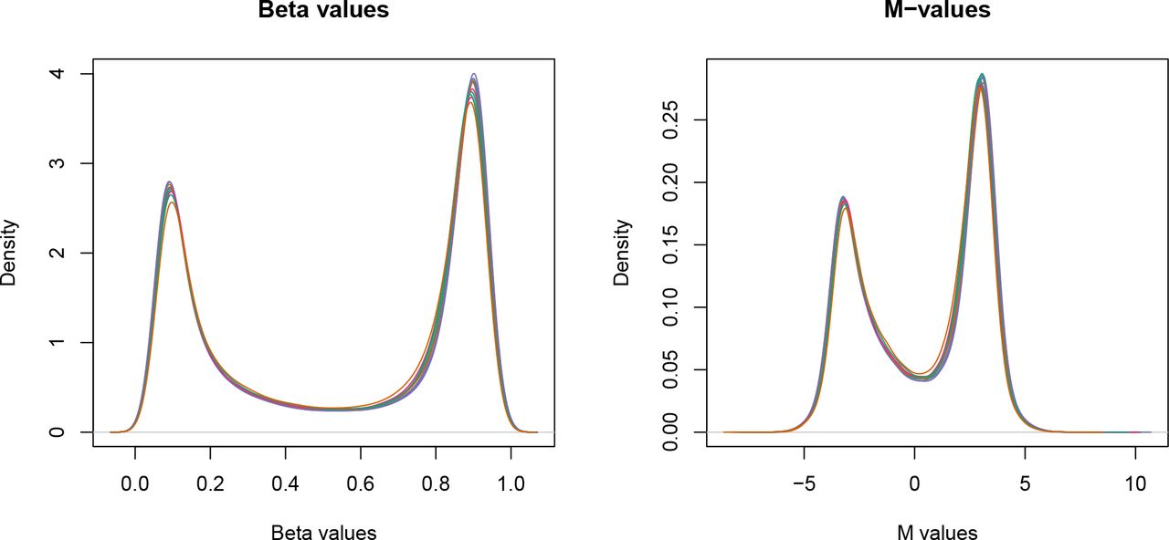
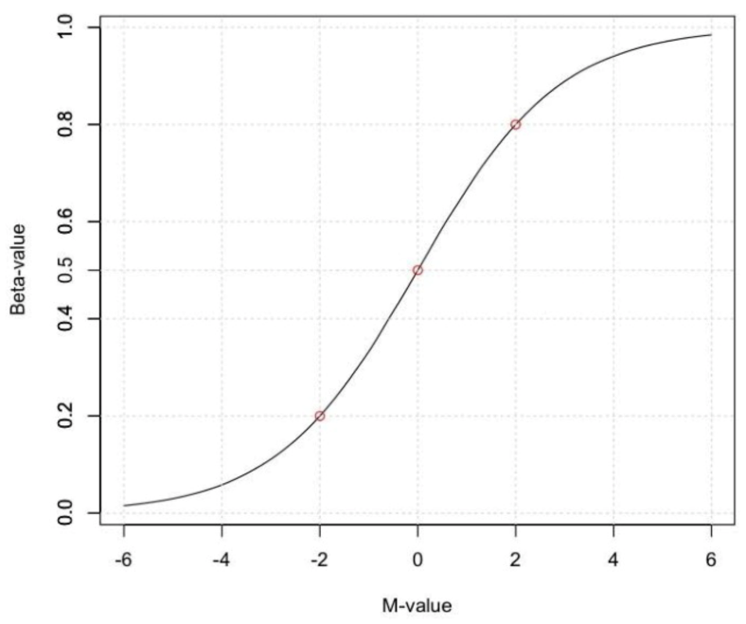
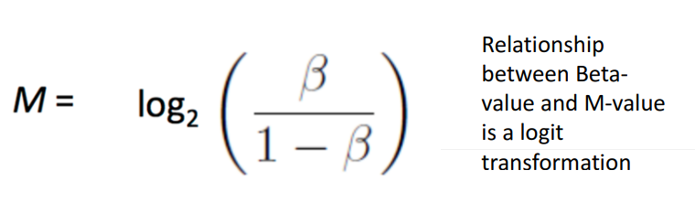
6. QUALITY CONTROL OF DNA METHYLATION DATA
Beta values
from 0 to 1
more intuitive interpretation
M values
-inf to + inf
more statistically valid
less intuitive interpretation

Slide 22
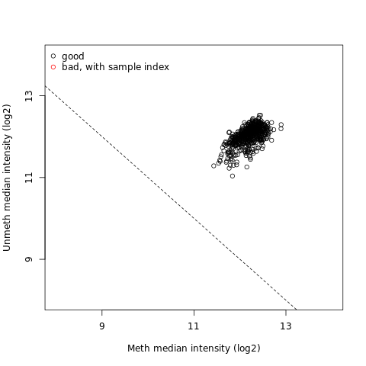
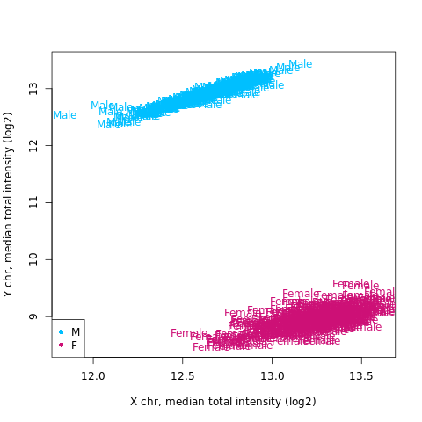
6. QUALITY CONTROL OF DNA METHYLATION DATA
2. Sample quality control
2.1. Overall low quality (methylated vs unmethylated signals)
2.2. Sample call rate (filter samples with % detected probes <95-98%)
2.3. Number of detected beads (filter samples with too few detected beads <3)
2.4. Sex consistency (sex chromosomal probes)
2.5. Technical duplicates (SNP probes)
2.6. DNA contamination (SNP probes)
2.7. Genetic consistenty (SNP probes vs GWAS)

Slide 23
6. QUALITY CONTROL OF DNA METHYLATION DATA
3. CpG probe quality control
3.1. CpG probe call rate (filter probes with % detected probes <95-98%)
3.2. Number of detected beads (filter probes with too few detected beads <3)
3.3. Problematic probes (later in the QC pipeline) --- el meffil ho fa internament??? Mirar si només hi ha cg probes
Array control probes
SNP probes
Non-CpG methylation probes
CpG probes in sex chromosomes
CpG probes with cross-hybridyzation problems
CpG probes with SNPs in the CpG site
CpG probes with SNPs in other positions
Illumina manifest: https://support.illumina.com/downloads/infinium-methylationepic-v1-0-product-files.html
Zhou’s list: https://github.com/zhou-lab/InfiniumAnnotation
Annotation
Recommended list of probes to eliminate

Slide 24
6. QUALITY CONTROL OF DNA METHYLATION DATA
4. Normalization
4.1. Background noise correction
4.2. Color bias correction
4.3. Probe bias correction
4.4. Across array normalization
No consensus on best method

Slide 25
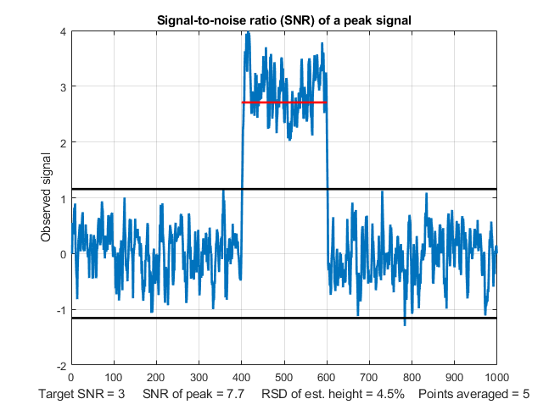
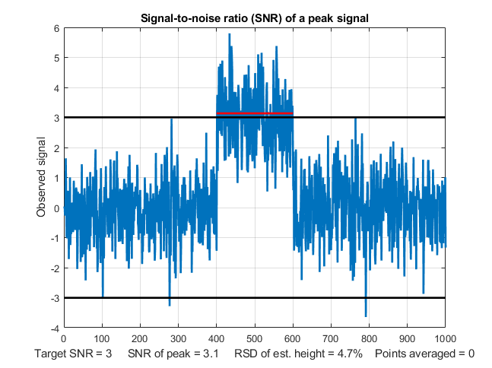
6. QUALITY CONTROL OF DNA METHYLATION DATA
4.1. Background noise correction
To remove noise from the data
Often use negative control probes to remove this noise, but also other methods
Tools: GenomeStudio (Illumina) or some R packages

Slide 26
6. QUALITY CONTROL OF DNA METHYLATION DATA
4.2. Color bias
The two color channels are known to perform differently (red>green)
Method: signal / average signal of the internal normalisation control for that color
Tools: GenomeStudio, and several R packages
After background noise and color bias are remove, beta values are calculated

Slide 27
6. QUALITY CONTROL OF DNA METHYLATION DATA
4.3. Probe bias correction
Type I and II probes behave different
It can be a problem in some type of analysis where
we rank or combine probes (clustering, regional analysis…),
but not for single CpG analyses
Methods: peak based correction, BMIQ, SWAN

Slide 28
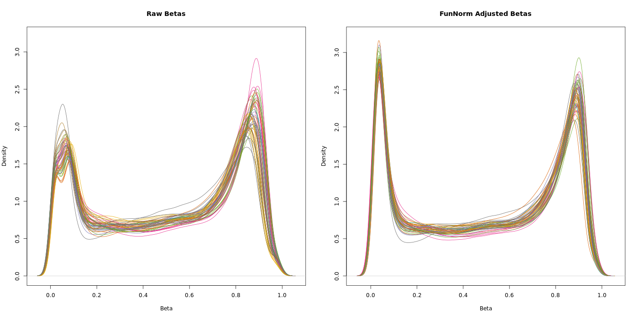
6. QUALITY CONTROL OF DNA METHYLATION DATA
4.4. Across array normalization

Slide 29
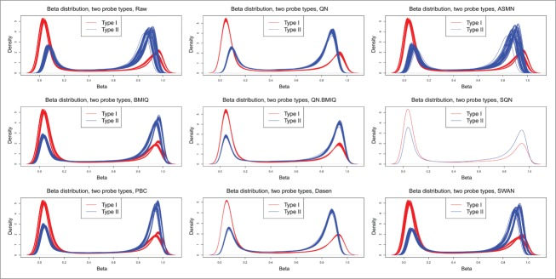
6. QUALITY CONTROL OF DNA METHYLATION DATA
4.4. Across array normalization
There are many different methods:

Slide 30
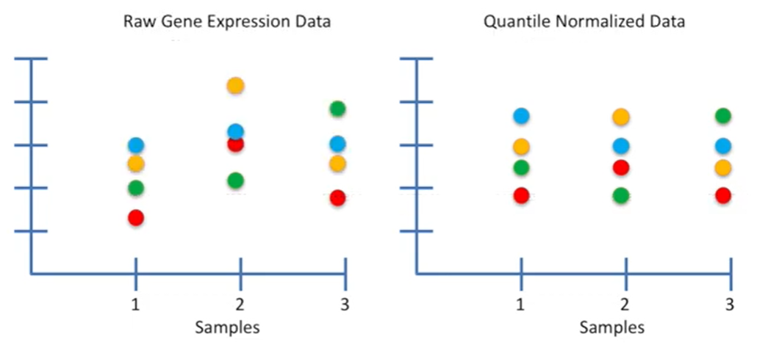
6. QUALITY CONTROL OF DNA METHYLATION DATA
4.4. Across array normalization
Quantile normalization
Normalises data to average/median of all observations
From gene expression arrays
Not best option for DNA methylation
Functional normalization
Quantile normalisation of control probes only
Functional normalization + residuals PCs???? Meffil…
https://www.youtube.com/watch?v=ecjN6Xpv6SE

Slide 31
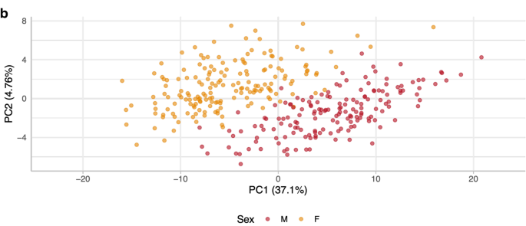
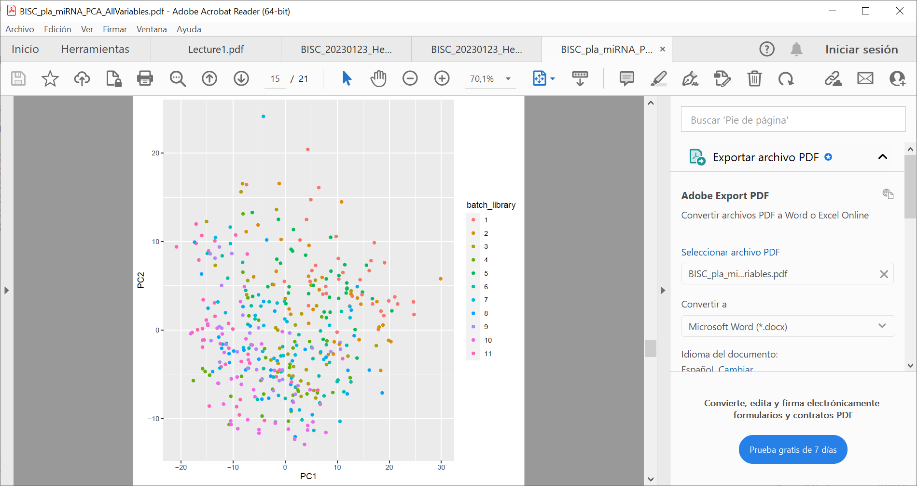
6. QUALITY CONTROL OF DNA METHYLATION DATA
5. PCA and technical batch effect correction
Principal component analyses (PCA)
Main variables explaining variance:
Biological variables
Tissue
Sex
Age
Ancestry
Disease (ie. cancer)
Technical batch variables
DNA extraction batch
Bisulfite conversion batch
Array
Position in array
batch

Slide 32
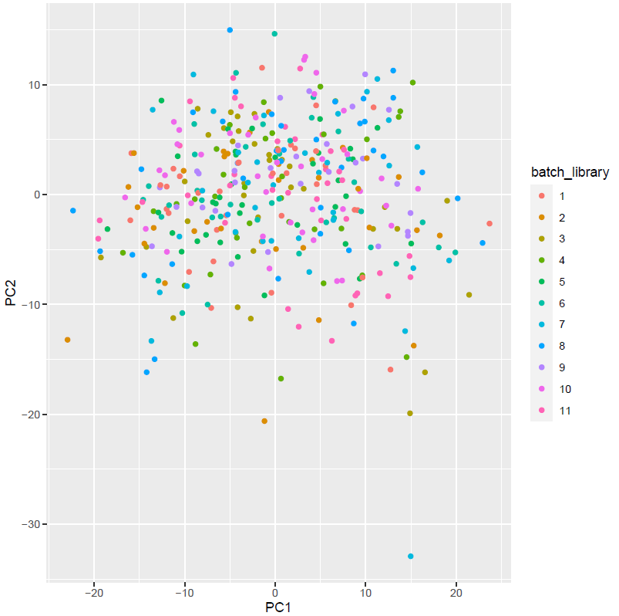
6. QUALITY CONTROL OF DNA METHYLATION DATA
5. Technical batch effect correction
Technical batch correction methods:
Known technical batch variable:
Add variable in the regression models
Omics R package: residuals of known variable
ComBat R package: Bayesian approach
Unknown technical batch variables:
Surrogate variable analysis (SVA)
Residuals
Add SVs in the regression model (this one!)
Before ComBat
After ComBat
batch

Slide 33
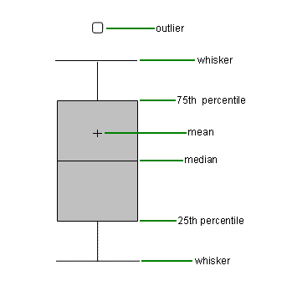
6. QUALITY CONTROL OF DNA METHYLATION DATA
6. Control of outlier values
Extrem values in the data
Problematic in DNA methylation
Outlier correction methods:
Trimming
To delete values that we do not believe
Define outlier (ie. 4*IQR)
Winsorising
To retain the high-value responses but not take them too literally
Take top values and bring them to lower values (ie. p99)

Slide 34
meffil R package
meffil R package
https://pubmed.ncbi.nlm.nih.gov/29931280/
https://github.com/perishky/meffil
Import raw IDAT files: yes
Sample quality control
2.1. Overall low quality: yes
2.2. Sample call rate: yes
2.3. Number of detected beads: yes
2.4. Sex consistency: yes (Aryee et al., 2014)
2.5. Technical duplicates: NA
2.6. DNA contamination: NA
2.7. Genetic consistenty: yes
Probe quality control:
3.1. CpG probe call rate: yes
3.2. Number of detected beads: yes
3.3. Problematic probes: sex chr
Normalization:
4.1. Background noise correction: ‘noob’ method (Triche et al., 2013)
4.2. Color bias correction: ‘noob’ method (Triche et al., 2013)
4.3. Probe bias correction: NA
4.4. Across array normalization: functional normalization (Fortin et al., 2014) + extension to fixed and random effects
5. PCA ant technical batch effect correction: PCA, PC associations, SVA during analysis
6. Control of outlier values: outside the package

Slide 35
INTRODUCTION TO EPIGENOME-WIDE ASSOCIATION STUDIES (EWAS)
2. PRE-PROCESSING OF DNA METHYLATION DATA
(PRACTICAL SESSION)

Slide 36
QUALITY CONTROL OF DNA METHYALTION DATA
Data: Subset from GEO XXXXXXX (N=XX)
Array: 450K
Tissue: blood
Ancestry: White European
Sex: males and females
Smoking: never, former, current
Age: yes
Array batch: yes
Input: IDAT files
Output: ExpressionSet with matrix of beta values + covariates dataframe (exposure, covariates, cells)
Tool: meffil R package
Questions:
Is there any sample that is excluded due to the low quality?
Is there any sample that is excluded due to inconsistent sex?
Which are the main biological and technical variables associated with PC1?

